Slide 1

Achievement 3: Rockbuster Performance
Janaya Brown
03/03/2023

Slide 2
AGENDA
1. Analysis Goals
4. Highest Performing Cities
2. Data Summary
5. Top Customers
3. Highest Performing Countries
6. Summary

Slide 3
1. Analysis Goals
Overview of inventory and revenue
Get a general understanding of our movie sales
Country-wide Performance
Determine top performing states
City-wide Performance
Determine top performing cities
Customer-level Revenue
Understanding how country-level performance looks
Understanding how city-level performance looks
Determine top customers
See how much customers are spending

Slide 4
2. Exploratory Data Analysis
Attributes | Statistic | Value
Rental Duration (number of times a movie is rented) | Average | 4.985
 | Minimum | 3
 | Maximum | 7
Rental Rate (rate to rent the movie in USD) | Average | 2.98
 | Minimum | 0.99
 | Maximum | 4.99
Replacement Cost (cost to replace the movie in USD) | Average | 19.98
 | Minimum | 9.99
 | Maximum | 29.99
Film length (duration of the movie in minutes) | Average | 115
 | Minimum | 46
 | Maximum | 185
Rating (parental guidance rating of the movie) | Mode | PG-13
Each movie should yield an average of $14.86 USD each purchase
(avg. rental duration x avg. rental rate)
Need to see number of customer and how much they are spending

Slide 5
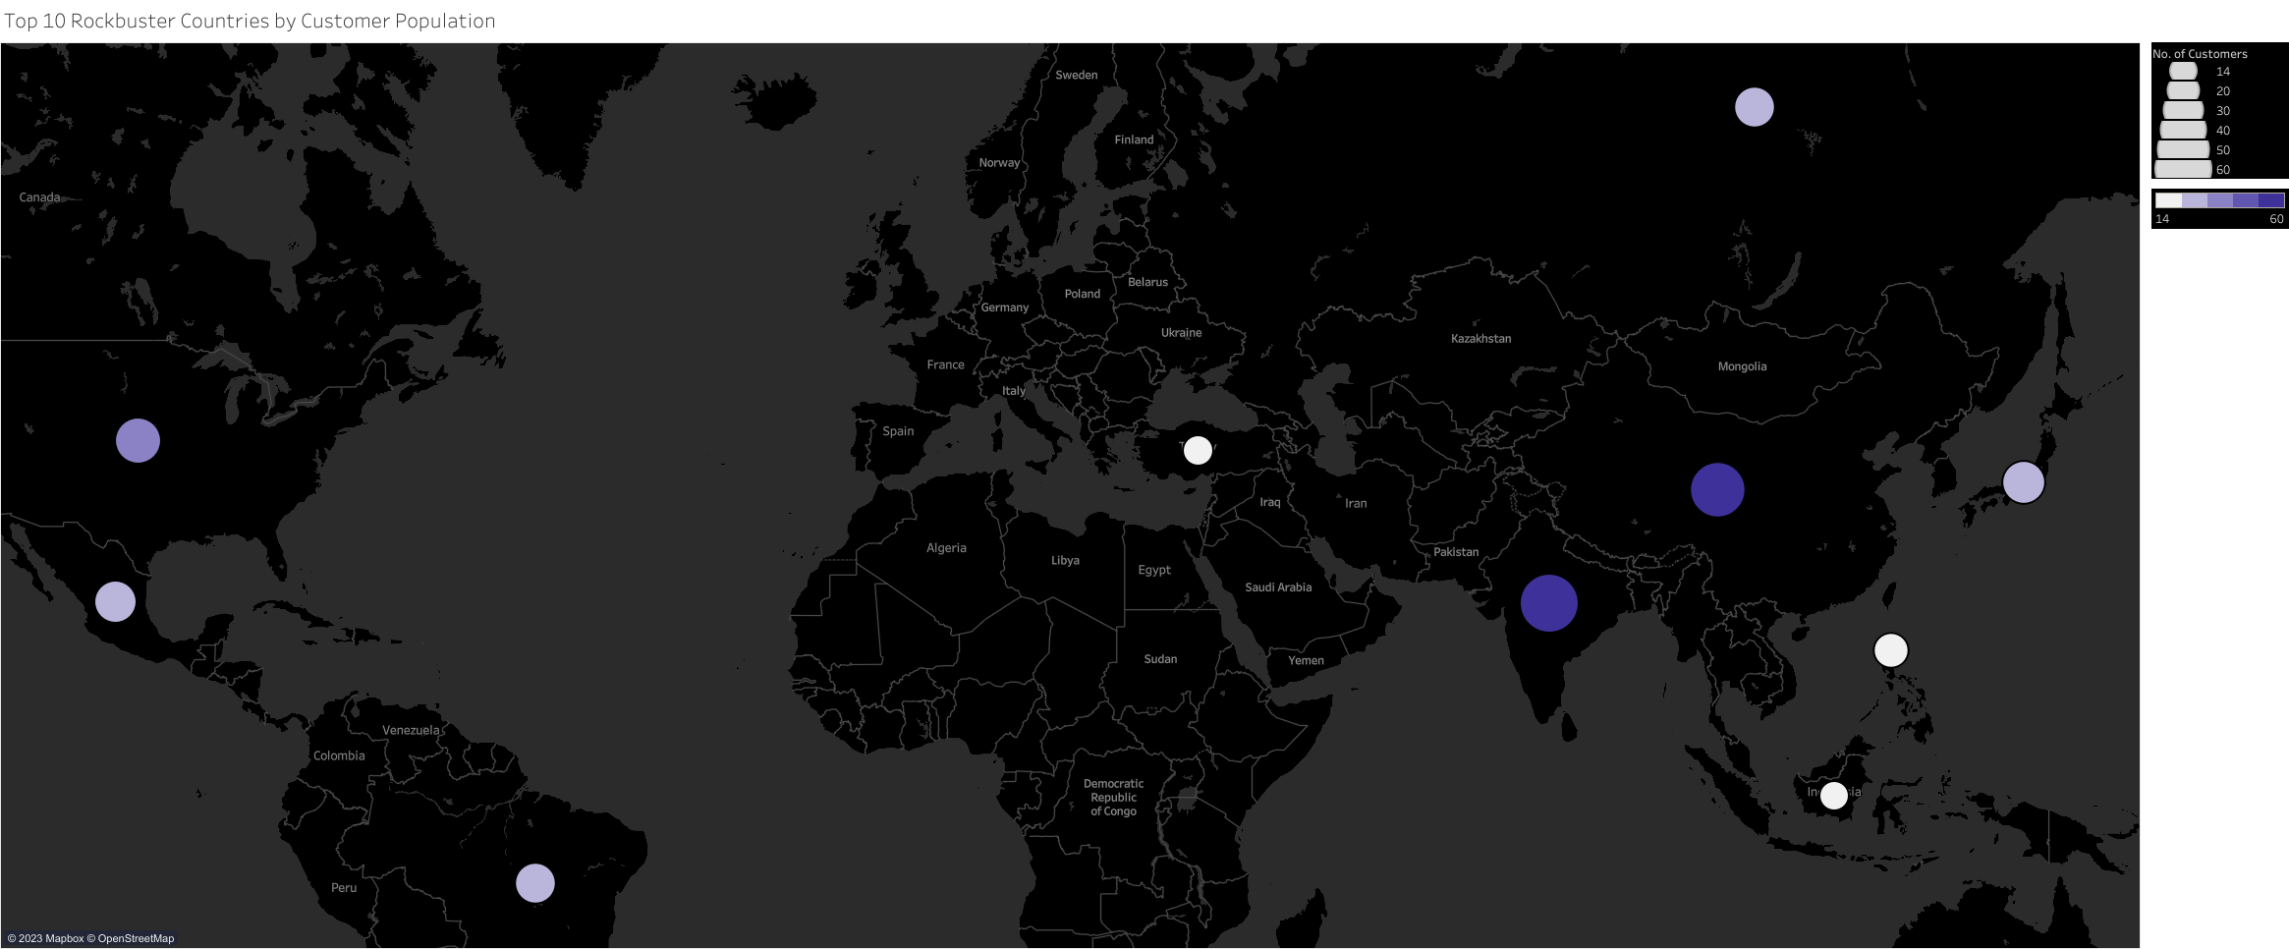
3. Highest Performing Countries
Performance determined by number of customers in the country
India
China
United States
Japan
Mexico
Brazil
Russian Federation
Philippines
Turkey
Indonesia
The top countries have a wide range of customer populations, but none are over 100
Link to Tableau visual

Slide 6
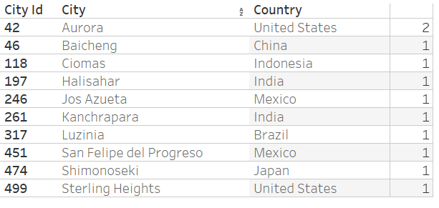
4. Highest Performing Cities
Performance determined by number of customers in the city
Only evaluated cities in the top 10 countries
The United States, India, and Mexico have the most high-performing cities
Most cities only have 1 customer
Link to Tableau visual

Slide 7
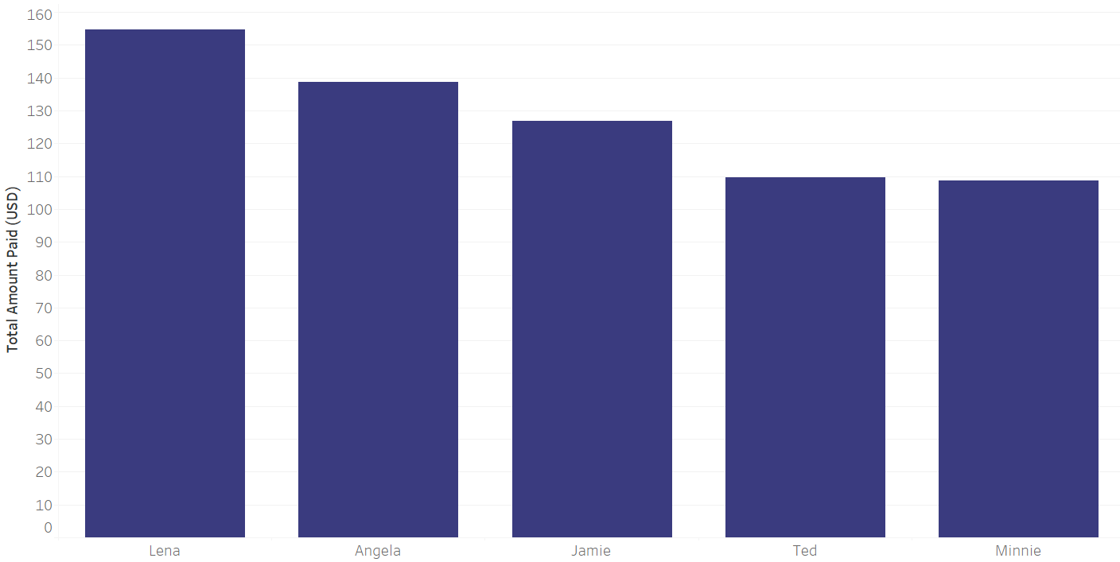
5. Top Customers
Ranking determined by total amount the customer spent
Only evaluated customers in the top 10 cities
The top customers are from India, Japan, the United States, China, and Indonesia (left to right)
Top customers have spent well over $100 USD
Link to Tableau visual

Slide 8
6. Summary
Each movies yield an average of $14.86 USD each purchase
Top Countries
Top Cities
Top Customers
India
China
The United States
Japan
Mexico
Brazil
The Russian Federation
The Philippines
Turkey
Indonesia
Aurora, United States
Baicheng, China
Ciomas, Indonesia
Halisahar, India
Jos Azueta, Mexico
Kanchrapara, India
Luzinia, Brazil
San Felipe del Progreso, Mexico
Shimonoseki, Japan
Sterling Heights, United States
Lena Jensen, India
Angela Hernandez, Japan
Jamie Rice, United States
Ted Breaux, China
Minnie Romero, Indonesia
Customer population are low on both the country and city scales
The top customers spend large amounts on our products
Link to Tableau visual

